Slide 1
String Processing ⇒ Brute Force, Horspool, Boyer-Moore, etc.
Session 15

Slide 2
Agenda
Introduction
Brute Force Method
Horspool algorithm
Boyer-Moore algorithm
Trie
Suffix Tries
Summary

Slide 3
Introduction
A common problem in text processing and DNA sequence analysis - finding strings inside other strings
Suppose we have a text T consisting of an array of characters from some alphabet, Σ
The string matching problem is this: given a smaller string P (the pattern) that we want to find occurrences of P in S.
For example, in the string "ABABABAC", the pattern string "BAB" occurs at shifts 1 and 3.

Slide 4
Pattern Match & Replace
You are given a string called source string with length n and a pattern string with length m (m <= n).
The goal is to search the pattern in the source string.
If it is found, then return the position or index of the first occurrence.
Suppose if the pattern is not found, then return -1.

Slide 5
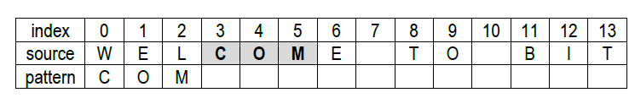
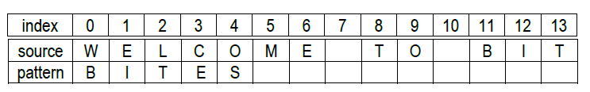
Example
Pattern found
Pattern not found

Slide 6
Logic: Brute-force
Maintaining two pointers, say, i and j for source string (s) and pattern string (p) respectively
We start comparing the characters pointed by i and j, i.e. s[i] = p[j].
If both are equal, then advance the pointer j and compare again with s[i + j].
Note that we should not advance i also, because first few characters of s may be equal to p and afterwards it may not.

Slide 7
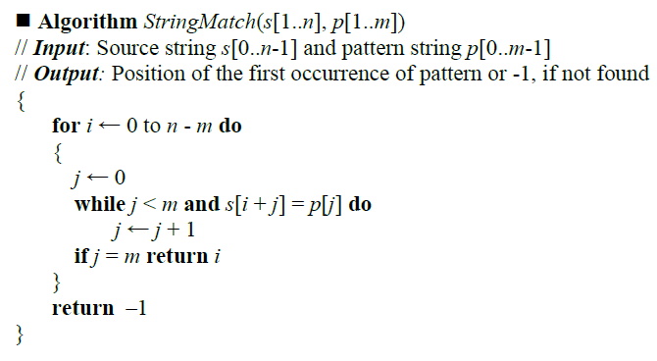
Algorithm

Slide 8
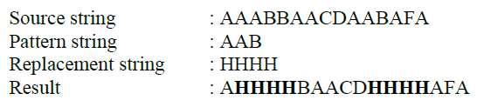
Pattern Match and Replacement
Pattern match and replacement problem can be stated as
“given a source string, search for the pattern string. If it is found, then replace all occurrences of that pattern with the supplied replacement string”.

Slide 9
C Program
int StringMatch(char s[], char p[], char r[], char f[])
{
// i-index src, j-index pattern,
// k-index replace, t-index final
int i, j, k, m, t;
int found = 0;
j = m = i = t = 0;

Slide 10
while (s[i] != '\0')
{
if (s[m++] == p[j++]) // check for matching
{
if (p[j] == '\0') // pattern found
{
// copy replace string in final string
for(k=0; r[k]!='\0'; k++,t++)
f[t] = r[k];
j = 0;
i = m;
found = 1;
}
}
else // mismatch
{
f[t++] = s[i++];
m = i;
j = 0;
}
} // end of while
f[t] = '\0';
return found;
}

Slide 11
Horspool algorithm
Method: shift the pattern depending upon whether the last character of the pattern matches with any particular character in the source
source | s₀ | s₁ | s₂ | s₃ | s₄ | c | . | . | s_{n-1}
pattern |  |  |  | B | I | T
source | W | E | L | C | O | M | E | T | O | B | I | T
pattern |  |  |  | B | I | T
 |  |  |  |  |  |  | B | I | T
source | I | N | D | I | A | I | N | T | O | P
pattern |  |  |  | B | I | T
 |  |  |  |  | B | I | T

Slide 12
Shift table
if c ≠ (m – 1) characters of the pattern
t(c) = m
else
t(c) = the distance from the rightmost c among the first (m – 1)
characters of the pattern to its last character.
pattern: B O R D E R
c | A | B | C | D | E | F | G | … | O | … | R | … | Z
t(c) | 6 | 5 | 6 | 2 | 1 | 6 | 6 |  | 4 |  | 3 |  | 6

Slide 13
Example 1
source | I | N | D | I | A | N | _ | B | O | R | D | E | R | _ | S | E | C | U | R | I
pattern | B | O | R | D | E | R
 |  |  |  |  |  |  | B | O | R | D | E | R
 |  |  |  |  |  |  |  | B | O | R | D | E | R
comparison is done between N of source string with R of pattern
they don't match we shift the pattern by 6 characters as specified in the shift table.
comparison is then between E and R
since t(c) of E is 1 the pattern is moved by 1 character position

Slide 14
Algorithms
■ Algorithm ShiftTable(P[0..m - 1])
// Input: Pattern Array P[0..m – 1]
// Output: Shift Table T[0..asize – 1]
for j ←0 to asize - 1 do
T[j] ← m //Initialize all elements of T [0..255] with m.
for j ← 0 to m - 2 do
T[P[j]] ← m – 1 – j // last char of pattern must be set to m
end ShiftTable.

Slide 15
Algorithms...
T[P[0]] = B = 6 – 1 – 0 = 5
T[P[1]] = O = 6 – 1 – 1 = 4
T[P[2]] = R = 6 – 1 – 2 = 3
T[P[3]] = D = 6 – 1 – 3 = 2
T[P[4]] = E = 6 – 1 – 4 = 1
T[P[5]] = R = 6

Slide 16
■ Algorithm Horspool(S[0..n - 1], P[0..m – 1])
// Input: Source string S[0..n – 1] and pattern string P[0..m – 1]
// Output: index of pattern in source, if found - otherwise -1
ShiftTable(P)
i ← m – 1
while i ≤ n – 1 do
k ← 0
while k ≤ m – 1 and P[m – 1 – k] = S[i – k] do
k ← k + 1
if k = m
return i – m + 1 // position of pattern in source
else i ← i + T[S[i]] // shift the pattern right of source
return –1 // pattern not in source
end Horspool.

Slide 17
Example 1
 | 0 | 1 | 2 | 3 | 4 | 5 | 6 | 7 | 8 | 9 | 0 | 1 | 2 | 3 | 4 | 5 | 6 | 7 | 8 | 9
source | D | R | A | W | _ | B | O | A | R | D | _ | B | O | R | D | E | R | S | _ | A
pattern | B | O | R | D | E | R
shift 5 |  |  |  |  |  | B | O | R | D | E | R
shift 6 |  |  |  |  |  |  |  |  |  |  |  | B | O | R | D | E | R
c | A | B | C | D | E | F | G | … | O | … | R | … | Z
t(c) | 6 | 5 | 6 | 2 | 1 | 6 | 6 |  | 4 |  | 3 |  | 6

Slide 18
Example 2
 | 0 | 1 | 2 | 3 | 4 | 5 | 6 | 7 | 8 | 9 | 0 | 1 | 2 | 3 | 4 | 5 | 6 | 7 | 8 | 9
source | N | E | W | _ | M | U | R | D | E | R | _ | C | A | S | E | _ | F | I | L | E
pattern | B | O | R | D | E | R
shift 6 |  |  |  |  |  |  | B | O | R | D | E | R
shift 6 |  |  |  |  |  |  |  |  |  |  |  |  | B | O | R | D | E | R
c | A | B | C | D | E | F | G | … | O | … | R | … | Z
t(c) | 6 | 5 | 6 | 2 | 1 | 6 | 6 |  | 4 |  | 3 |  | 6

Slide 19
Example 3
 | 0 | 1 | 2 | 3 | 4 | 5 | 6 | 7 | 8 | 9 | 0 | 1 | 2 | 3 | 4 | 5 | 6 | 7 | 8 | 9
source | C | A | R | _ | D | E | N | T | _ | B | O | R | D | E | R | _ | C | O | O | L
pattern | B | O | R | D | E | R
shift 1 |  | B | O | R | D | E | R
shift 6 |  |  |  |  |  |  |  | B | O | R | D | E | R
shift 2 |  |  |  |  |  |  |  |  |  | B | O | R | D | E | R
c | A | B | C | D | E | F | G | … | O | … | R | … | Z
t(c) | 6 | 5 | 6 | 2 | 1 | 6 | 6 |  | 4 |  | 3 |  | 6
Complexity: Θ(nm).

Slide 20
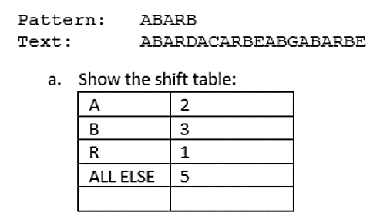
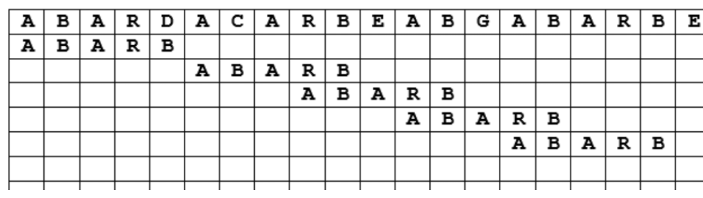
Exercise

Slide 21


Boyer and Moore Algorithm

Slide 22
Boyer-Moore algorithm
Based on same two ideas:
Comparing pattern characters to text from right to left
Looking-Glass Heuristic: When testing a possible placement of P against T, begin the comparisons from the end of P and move backward to the front of P.
Character-Jump Heuristic: During the testing of a possible placement of P within T, a mismatch of text character T[i]=c with the corresponding pattern character. P[k] is handled as follows.
If c is not contained anywhere in P, then shift P completely past T[i] (for it cannot match any character in P).
Otherwise, shift P until an occurrence of character c in P gets aligned with T[i].

Slide 23
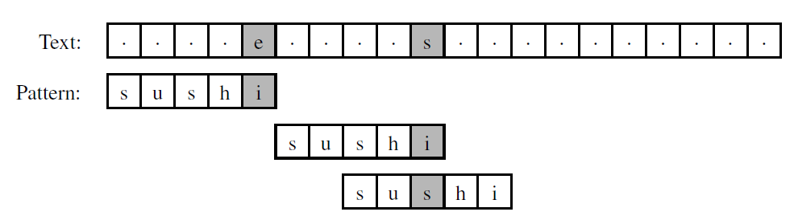
Example

Slide 24
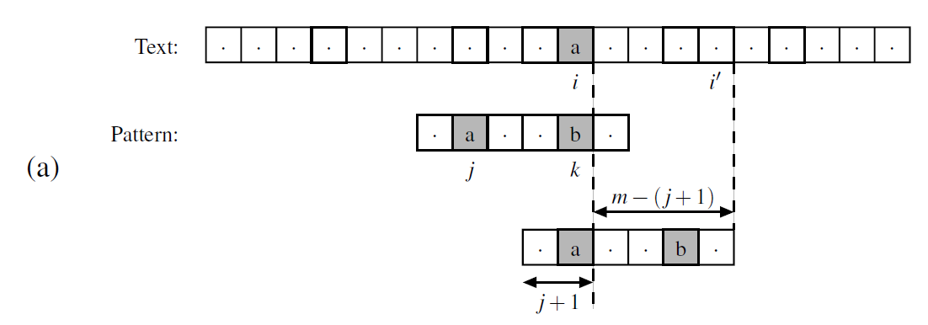
Concept
Additional rules for the character-jump heuristic of the Boyer-Moore:
Let i - index of the mismatched character in the text,
k - corresponding index in the pattern,
j - index of the last occurrence of T[i] within the pattern.
We distinguish two cases:
(a) j < k, in which case we shift the pattern by k− j units, and thus, index i advances by m−( j +1) units;
(b) j > k, in which case we shift the pattern by one unit, and index i advances by m−k units.

Slide 25
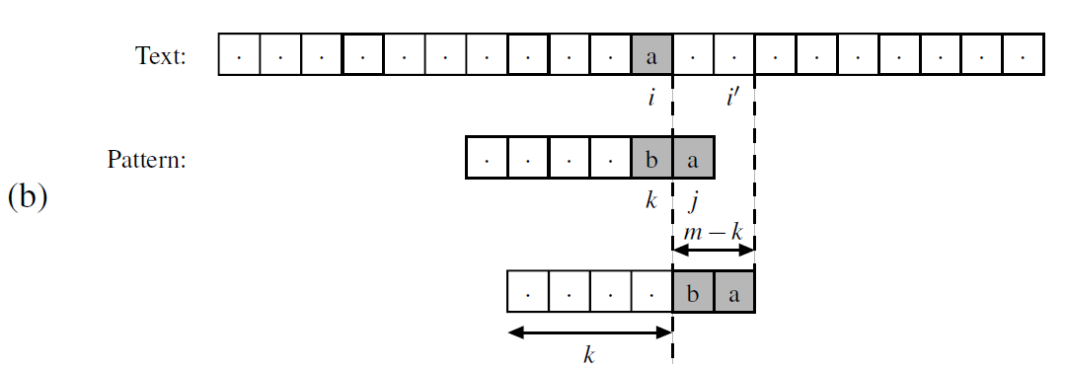
Concept..
Additional rules for the character-jump heuristic of the Boyer-Moore:
Let i - index of the mismatched character in the text,
k - corresponding index in the pattern,
j - index of the last occurrence of T[i] within the pattern.
We distinguish two cases:
(a) j < k, in which case we shift the pattern by k− j units, and thus, index i advances by m−( j +1) units;
(b) j > k, in which case we shift the pattern by one unit, and index i advances by m−k units.

Slide 26
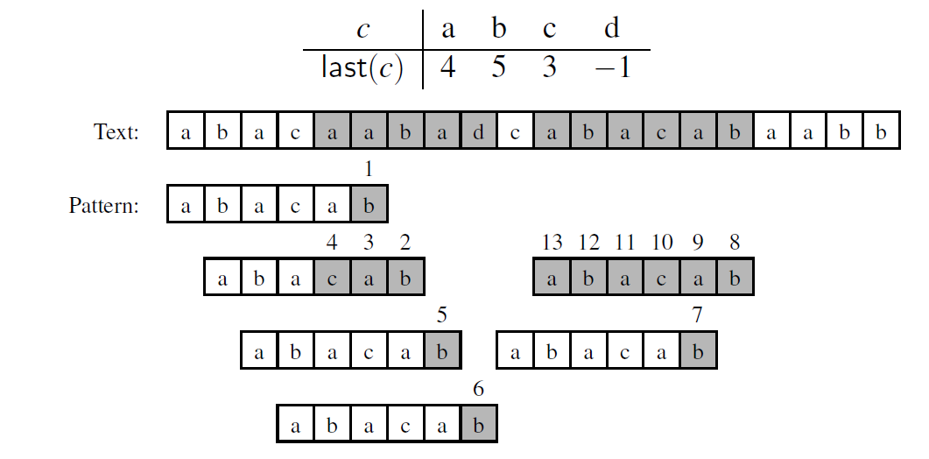
Example
i=5, j=4, k=5
i=4, j=4, k=3
i=7, j=4, k=5

Slide 27
Example-2
index | value
? | -1
A | 4
C | 3
T | 2
01234567890123456
T =ACTGACTACATCACTCA
P =ACTCA
ACTGACTACATCACTCA
*****ACTCA
ACTGACTACATCACTCA
*ACTCA
ACTGACTACATCACTCA
**ACTCA
*ACTCA
*ACTCA
**ACTCA
i=3, j = -1, k=4
i=7, j=4, k=2
i=10, j=2, k=4
i=9, j=4, k=1
i=13, j=3, k=4
i=14, j=2, k=4

Slide 28
Trie Data Structure
A trie, or prefix tree, is an ordered multi-way tree data structure that is used to store strings over an alphabet.
Unlike a binary search tree, no node in the tree stores the key associated with that node; instead, its position in the tree shows what key it is associated with.
Each node contains an array of pointers, one pointer for each character in the alphabet and all the descendants of a node have a common prefix of the string associated with that node.
The root is associated with the empty string and values are normally not associated with every node, only with leaves.

Slide 29
Contd…
A trie is a tree data structure that allows strings with similar character prefixes to use the same prefix data and store only the tails as separate data.
One character of the string is stored at each level of the tree, with the first character of the string stored at the root.
The term trie comes from "retrieval." Due to this etymology it is pronounced [tri] ("tree"), although some encourage the use of "try" in order to distinguish it from the more general tree.

Slide 30
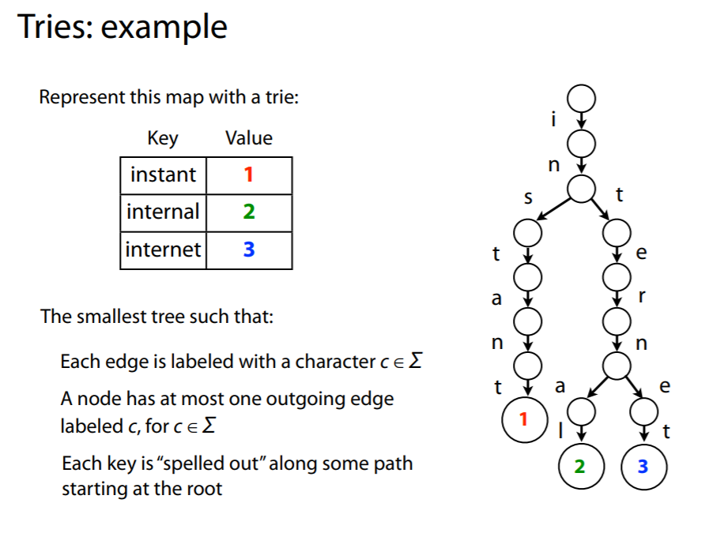

Slide 31
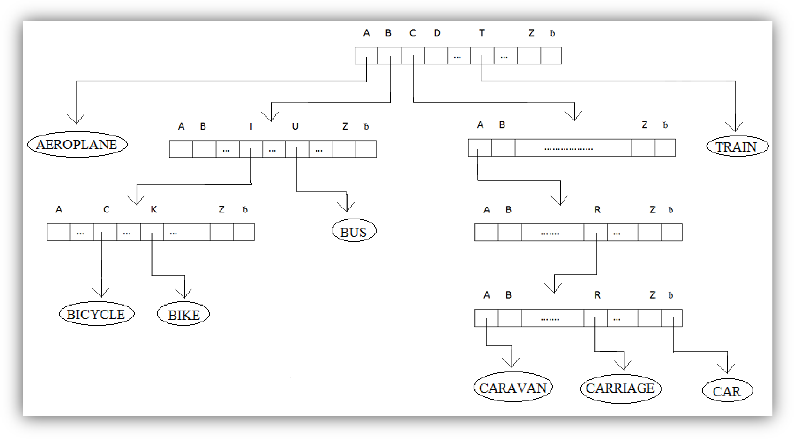
Example
Keys: AEROPLANE, BICYCLE, BIKE, BUS, CAR, CARAVANE, CARRIAGE, TRAIN.

Slide 32
Accessing an Info Node
Follow a path beginning from a branch node moving down each level depending on the characters forming the key, until the appropriate information node holding the key is reached.
The depth of an information node in a trie depends on the similarity of its first few characters (prefix) with its fellow keys.
Here, while AEROPLANE and TRAIN occupy shallow levels (level 1 branch node) in the trie, CAR, CARRIAGE, CARAVAN have moved down by 4 levels of branch nodes due to their uniform prefix “CAR”.

Slide 33
PSEUDO CODE
Step 1: For each character in the string, see if there is a child node with that character as the content.
If that character does not exist, return false.
If that character exist, repeat step 1.
Do the above steps until the end of string is reached.
When end of string is reached and if the marker (NotLeaf) of the current Node is set to false, return true, else return false.

Slide 34
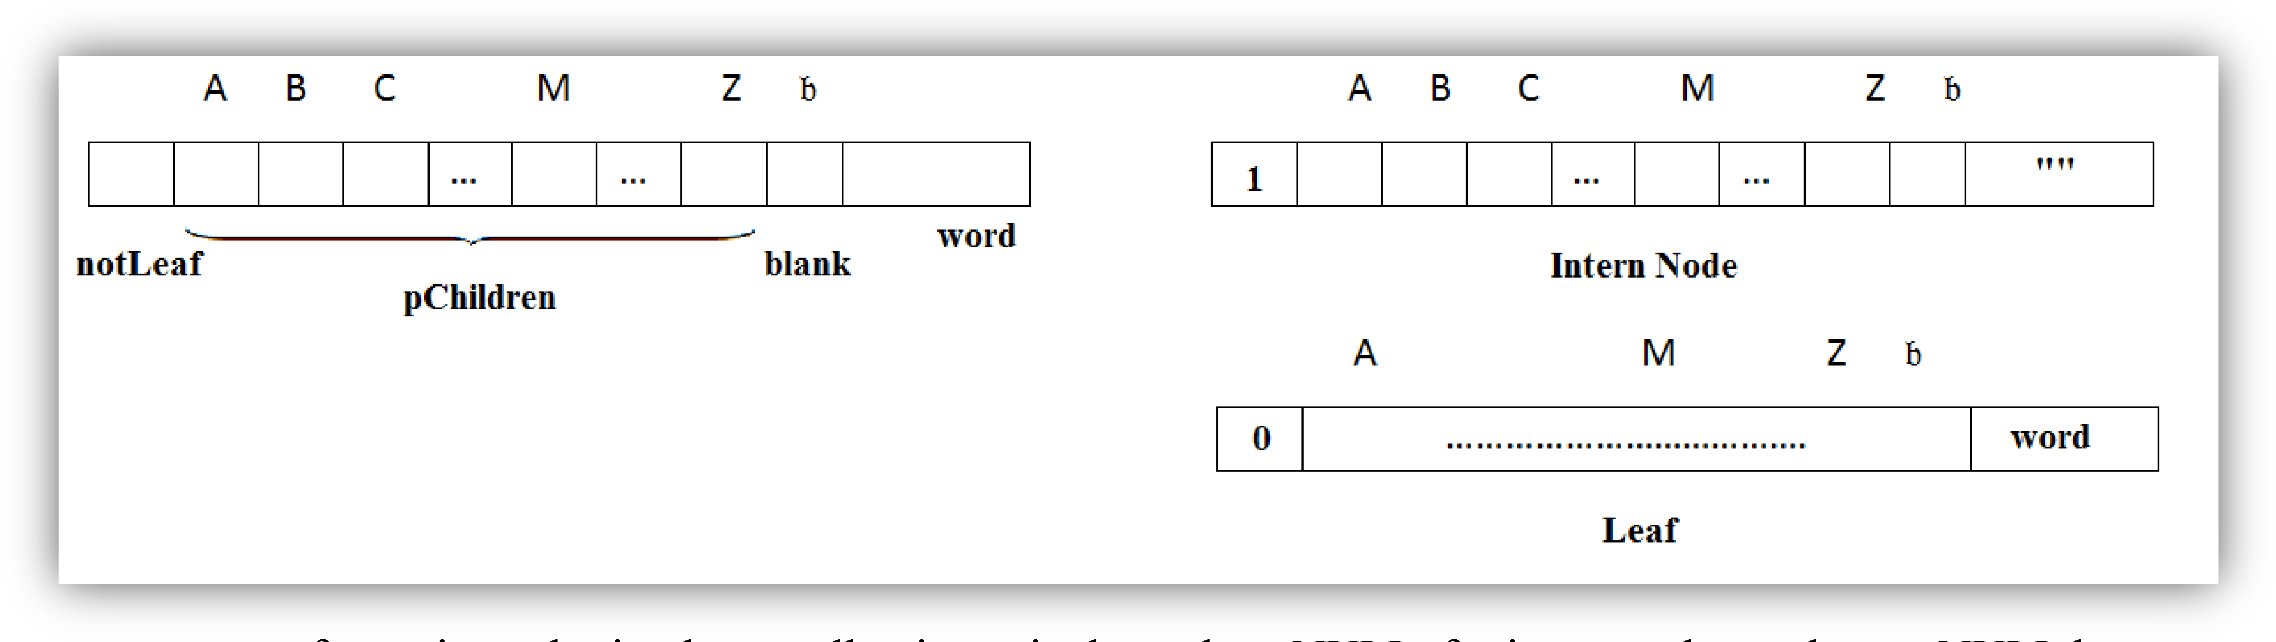
Trie Node Structure

Slide 35
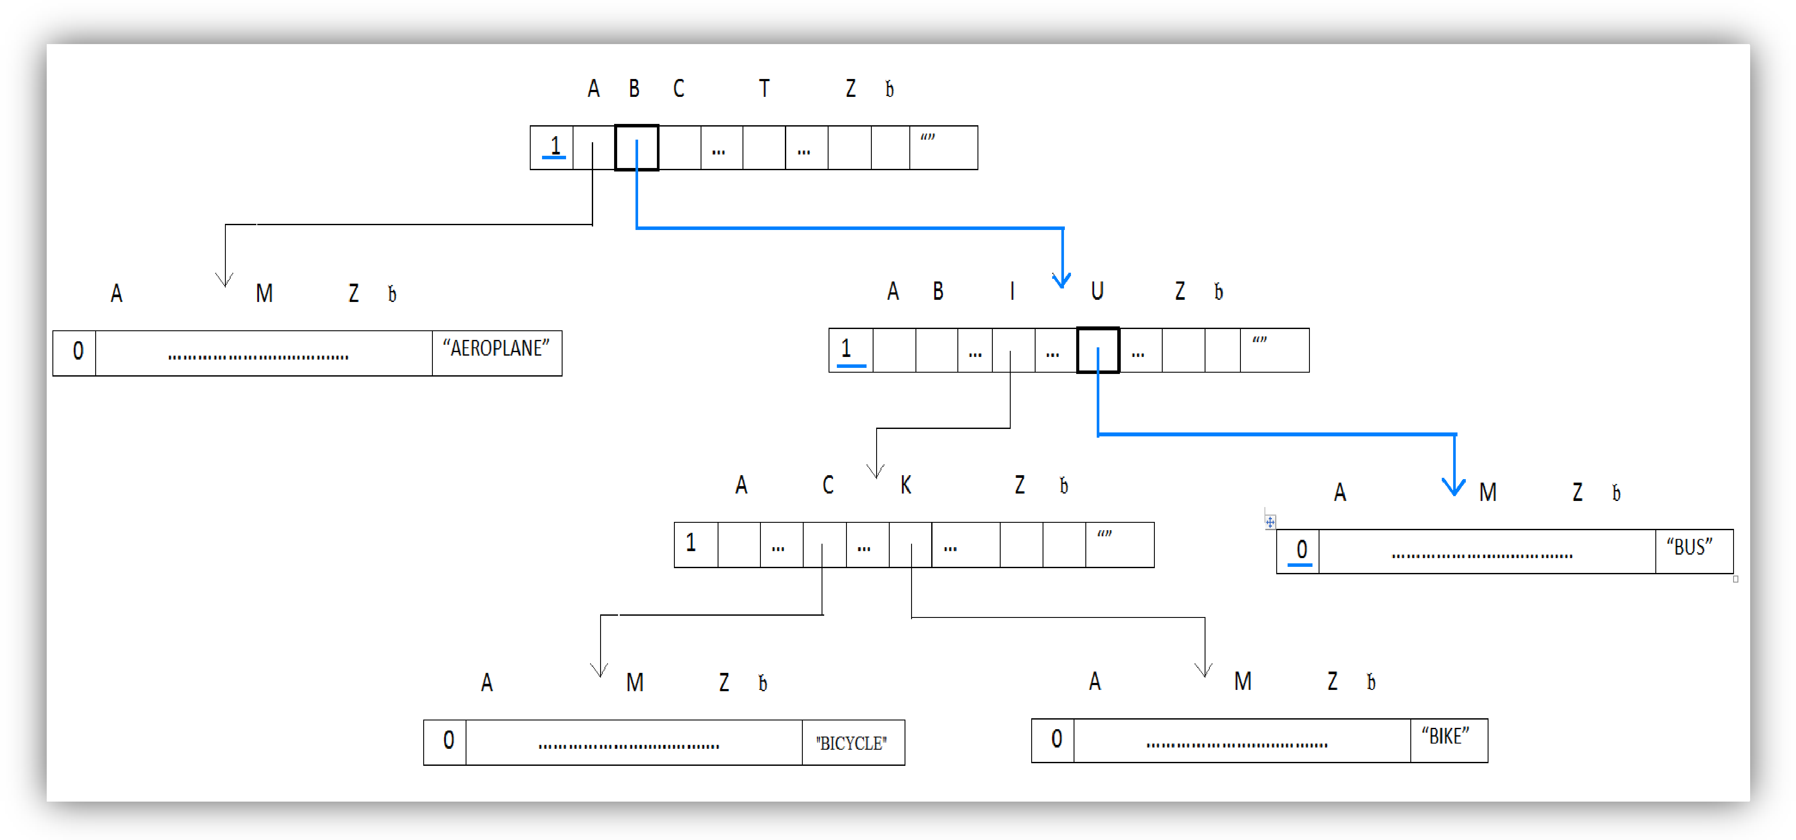
Example Search – “BU”

Slide 36
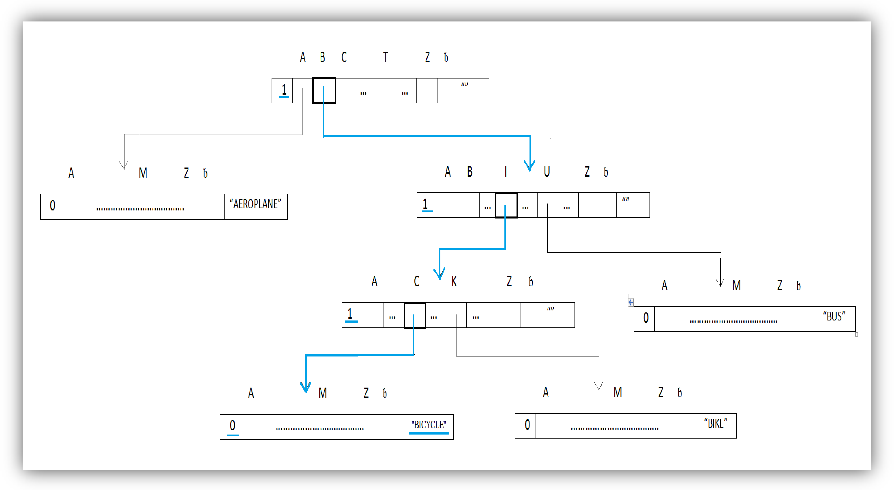
Example Search – “BICYCLE”

Slide 37
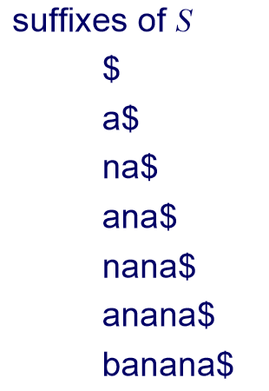
The Suffix Tree
A suffix tree (also called PAT tree or, in an earlier form, position tree) is a compressed trie containing all the suffixes of the given text as their keys and positions in the text as their values.
Suffix trees allow particularly fast implementations of many important string operations.
Proposition: The compact representation of a suffix trie T for a string X of length n uses O(n) space.
Example: S = banana$

Slide 38
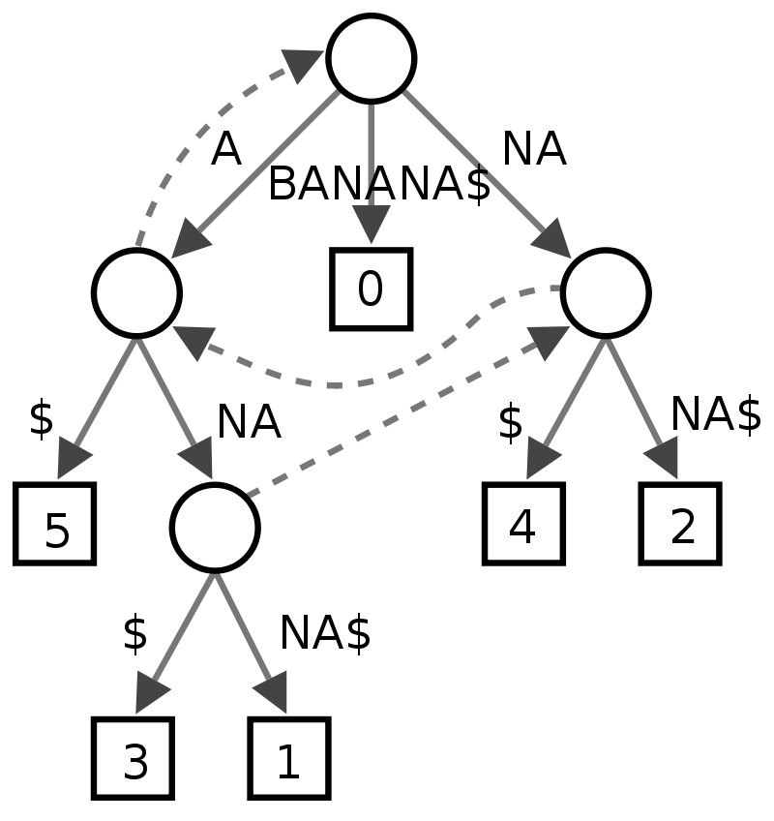
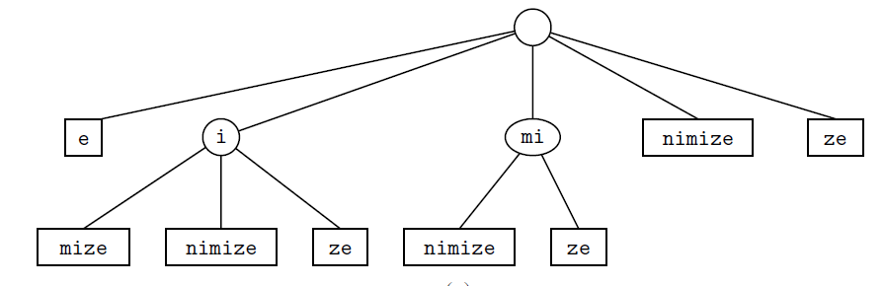
Examples
X = BANANA$
X = minimize

Slide 39
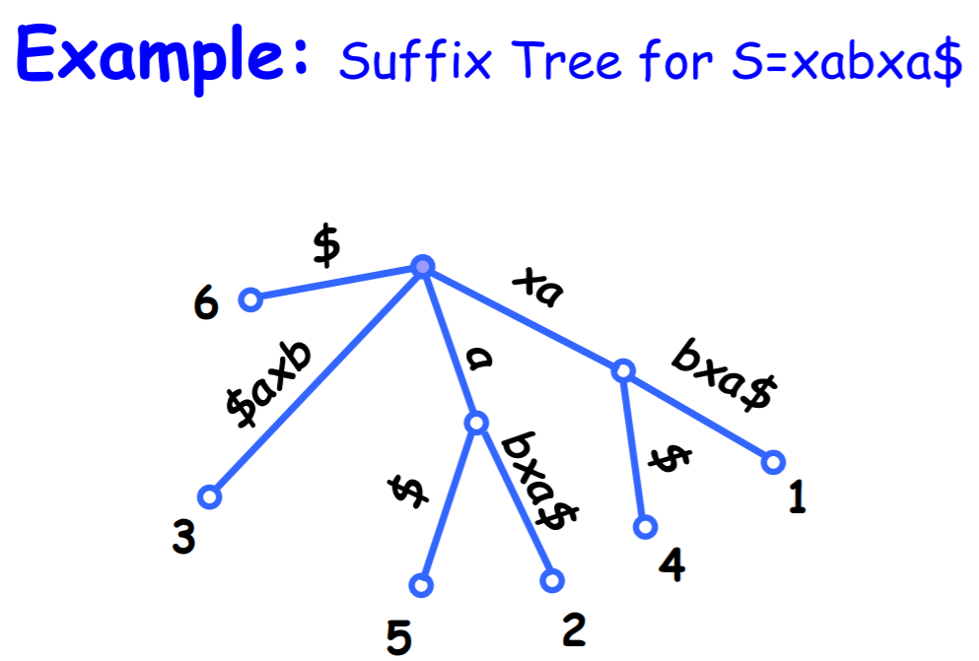

Slide 40
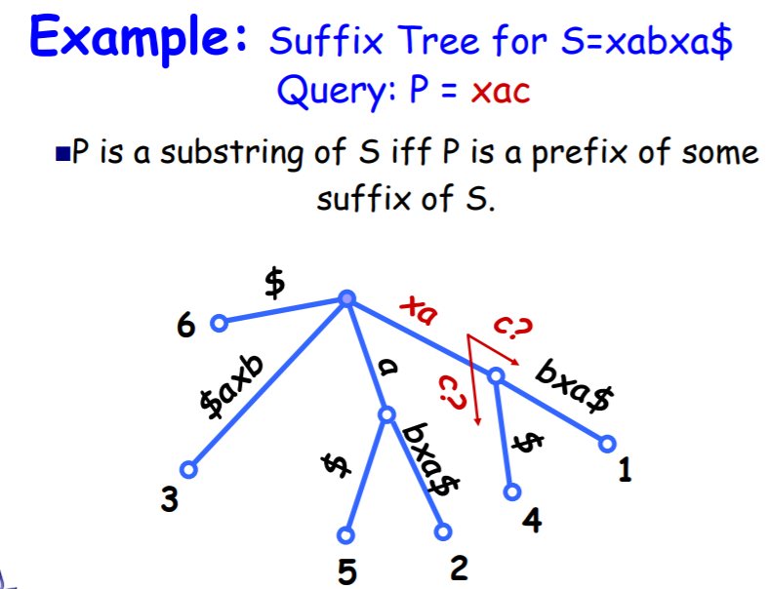

Slide 41
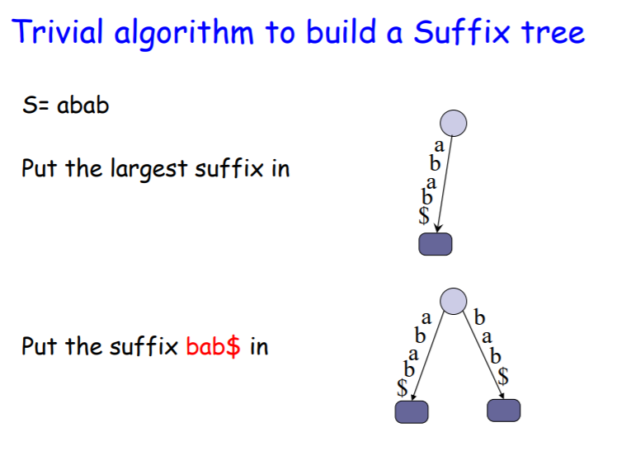

Slide 42
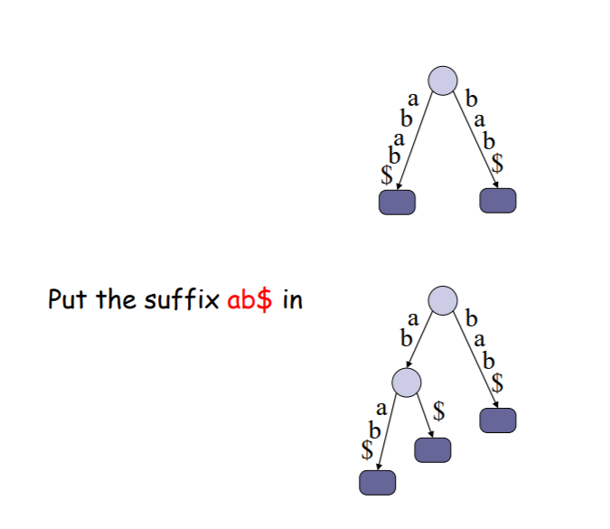

Slide 43
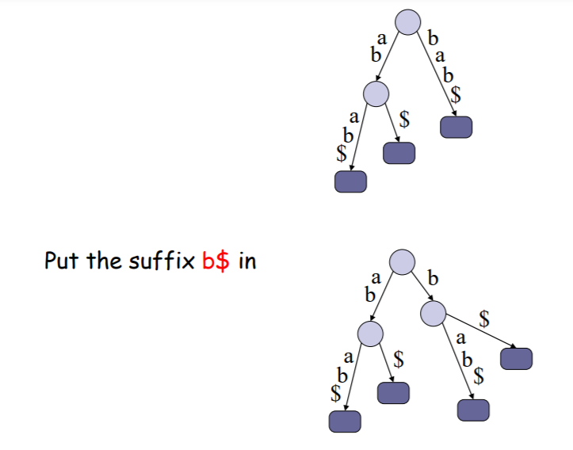

Slide 44
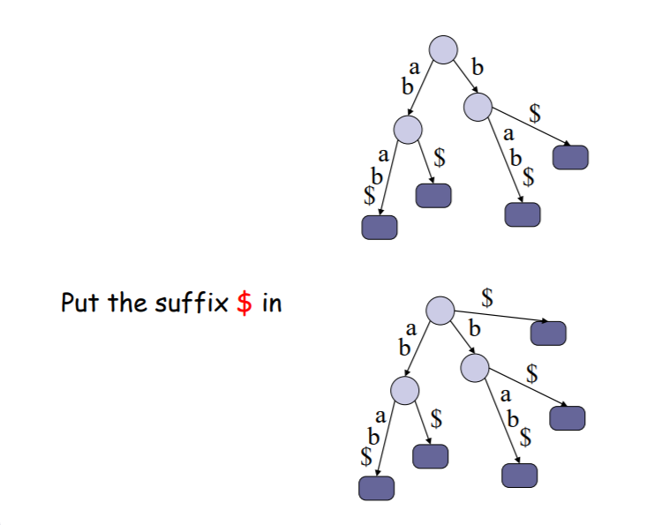

Slide 45
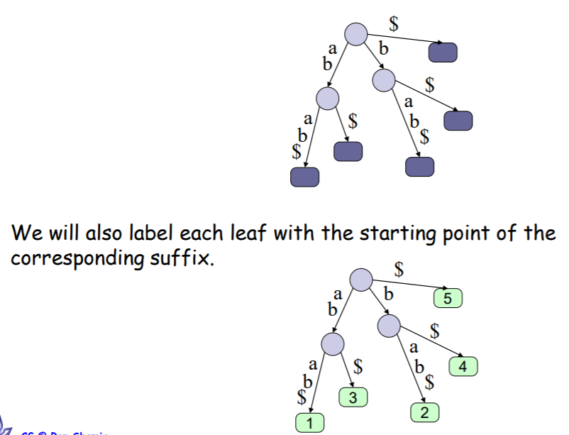

Slide 46
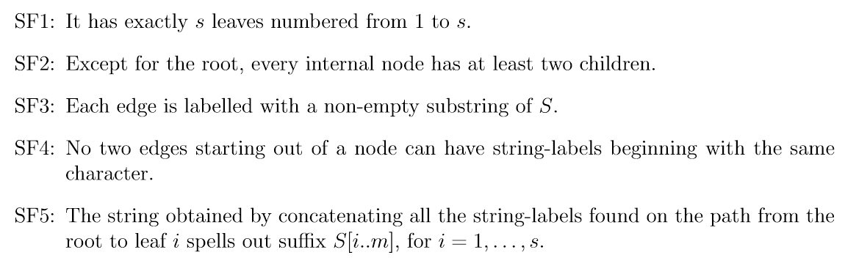
Properties
Let s is the length of the string

Slide 47
Search a Suffix Trie
FindMatch(Q, T):
follow (unique) path down from root of T according to characters in Q
if all of Q is found to be a prefix of such a path return label of some leaf below this path
else, return no match found

Slide 48
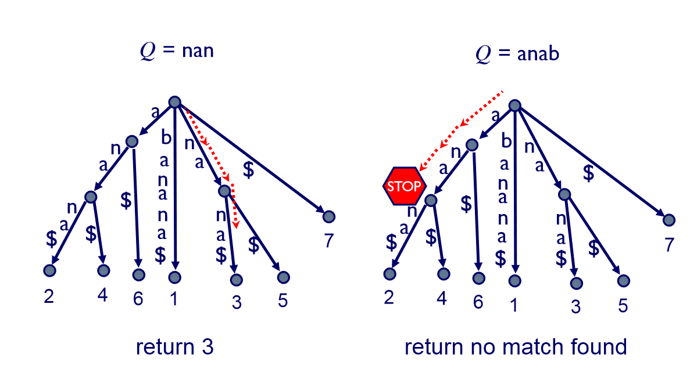
Search a Suffix Trie…
X = banana$
6
6
1
3
5
0
2
4
1
3
5
0
2
4

Slide 49
Applications
Find all occurrences of a pattern P.
Find all strings that contain a pattern P
Find the longest substring of S that appears at least m > 1 times.
Find the longest common substring of the strings S and T.
https://www.biostat.wisc.edu/bmi776/lectures/suffix-trees.pdf

